Slide 1
ADS Gym Management System

Slide 2

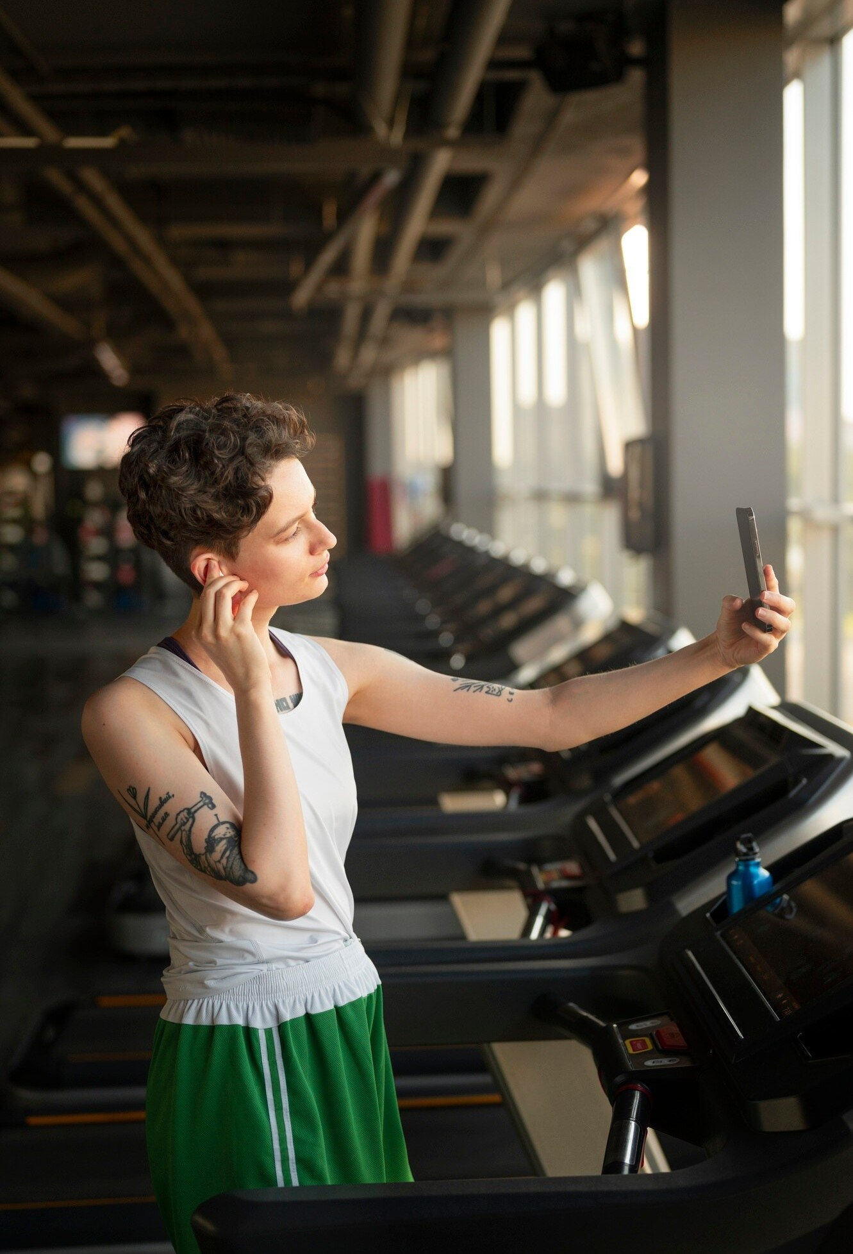
ADS GYM
What is ADS Gym?
ADS Gym is a dynamic fitness center dedicated to promoting health and wellness through expert-led programs, state-of-the-art facilities, and personalized training. It caters to individuals of all fitness levels, offering diverse classes, certified trainers, and flexible membership options. Through its online platform, ADS Gym ensures easy access to information, bookings, and secure transactions, making fitness convenient and engaging for everyone.

Slide 3

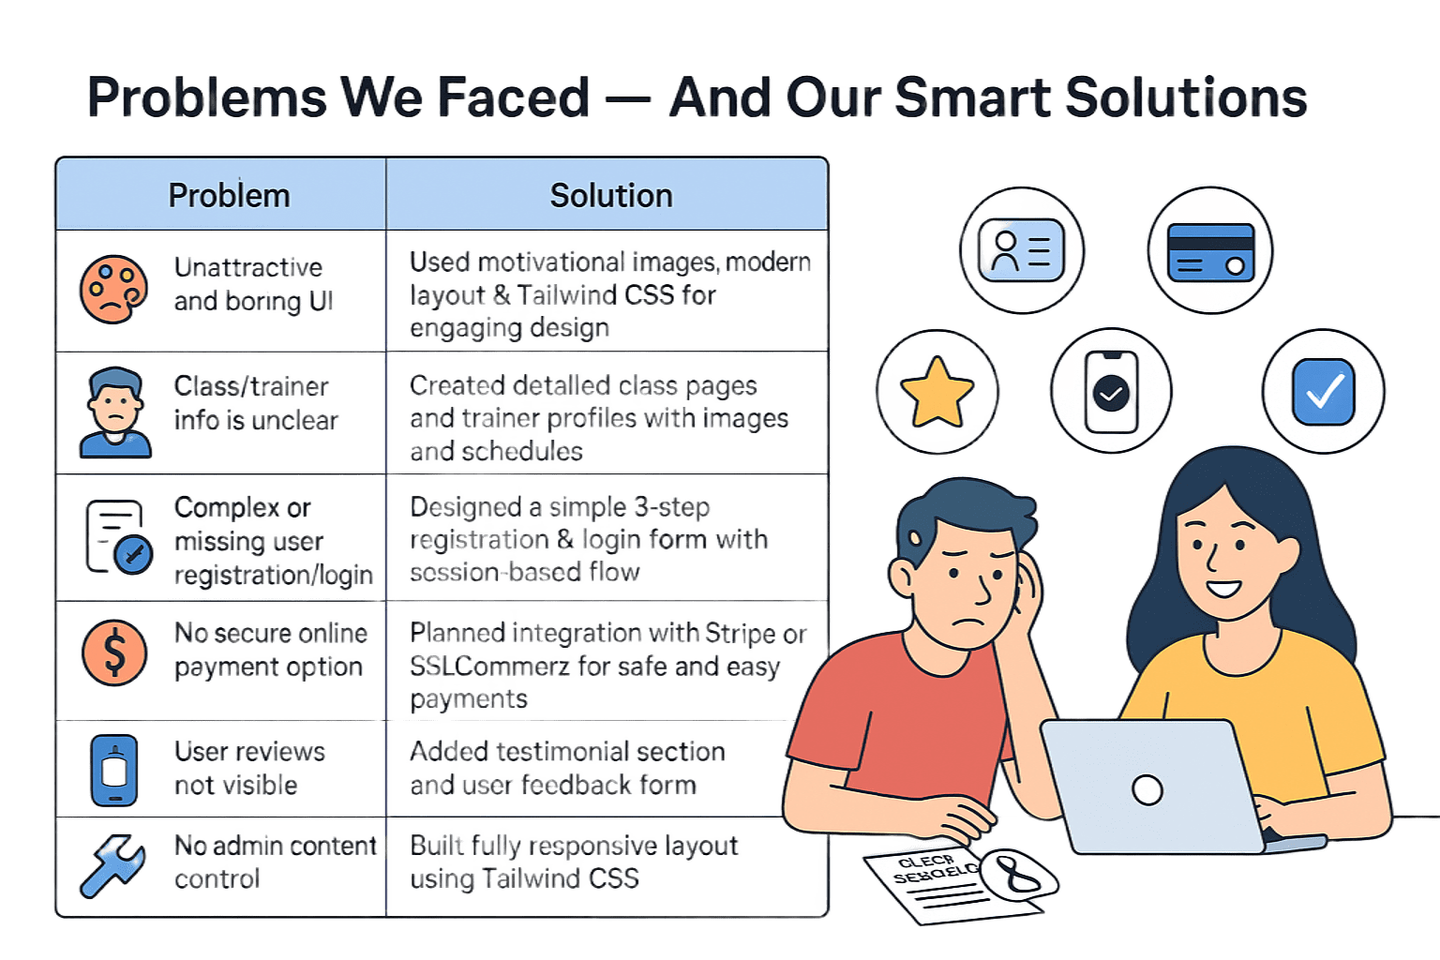

Slide 4
System Architecture
The ADS Gym website follows a simple static web architecture.
Users access the website through a web browser.
The frontend is developed using HTML, CSS, JavaScript, and Tailwind CSS.
The website is hosted on GitHub Pages.

Slide 5
Security Features
Basic security measures are applied to the website.
Secure contact form structure is used.
Input validation is implemented to prevent incorrect user data.
Future improvement may include authentication and encrypted payment systems.

Slide 6
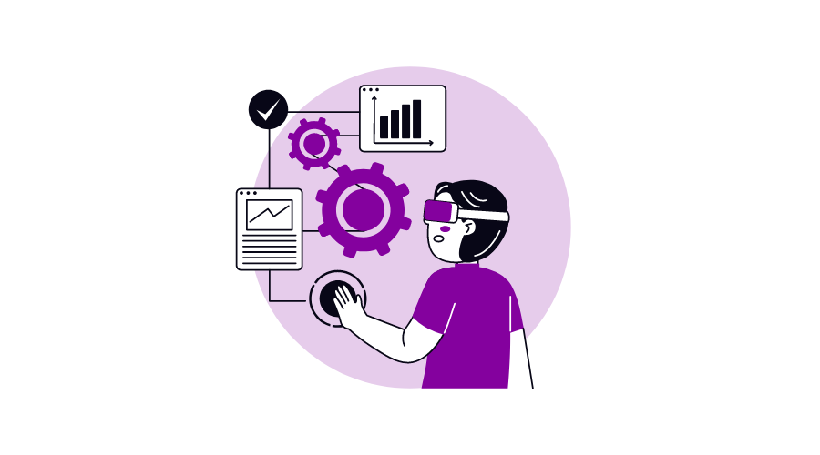
Functional Requirement
Display gym services and trainer details
Contact form with user input fields
Responsive navigation bar across all pages
Image galleries for gym and classes
Separate sections for membership info, reviews, and location

Slide 7
Non-Functional Requirement
Performance – Fast loading under 3 seconds
Responsiveness – Works on all screen sizes
Usability – Clean layout, user-friendly
Maintainability – Modular code structure
Availability – 24/7 uptime via GitHub Pages
Scalability – Easy to convert into a full-stack system

Slide 8
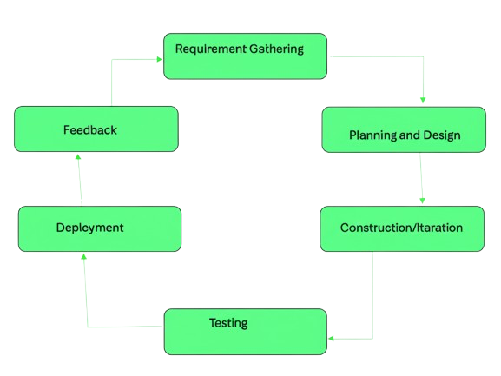
Software Process Model Used: Agile Model
They used the Agile Model to build the ADS Gym Management System because it allows flexibility, fast updates, and regular user feedback ,perfect for a dynamic project like this.
Why Agile?
Iterative Development: Work done in small steps (sprints).
Continuous Feedback: Users give input after each step.
Fast Changes: Easy to adjust as needs change.
Team Collaboration: Everyone (developers, testers, clients) works together.
Step-by-Step Delivery: New features added gradually and tested early.

Slide 9

Desing and Technology Used
Design Approach :
Focus on User Interface (UI) and User Experience (UX) for ease of use.
UI/UX: Figma
Technologies Used :
Frontend Technologies: HTML, CSS, JavaScript ,Tailwind(CSS Framework) for responsive design
Hosting: Netlify for hosted site display.

Slide 10
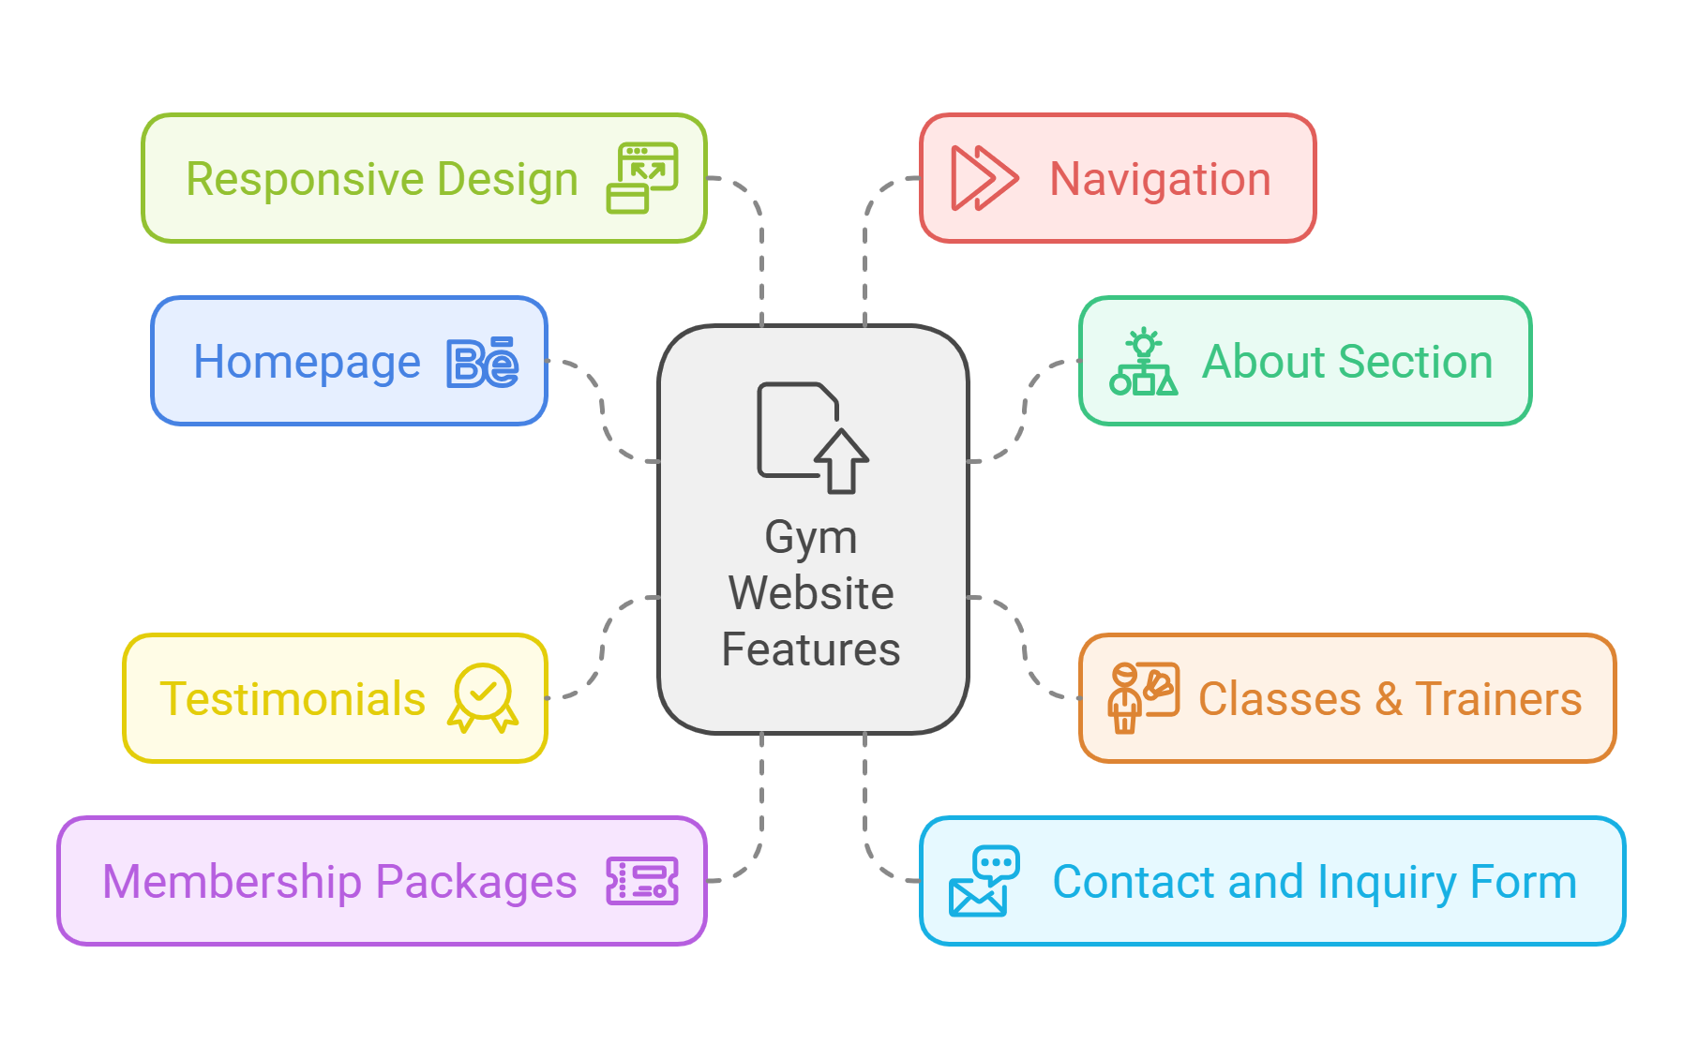
Project Overview
Homepage: Clean and motivational design that introduces users to the gym’s offerings.
About Section: Highlights the gym’s mission, vision, and core values.
Classes & Trainers: Comprehensive descriptions of available fitness classes and profiles of experienced trainers.
Testimonials: Positive feedback and success stories from clients to build credibility.
Membership Packages: Clear and flexible pricing options catering to diverse user needs, with 24/7 gym access.
Contact and Inquiry Form: Allows users to reach out for more information or assistance.

Slide 11
Testing Methods Used
Manual Testing for all pages
Responsive Testing for mobile, tablet, and desktop
Cross-Browser Testing (Chrome, Firefox, Edge)
Form Validation Testing for the contact form
Performance Testing to ensure fast load speed

Slide 12
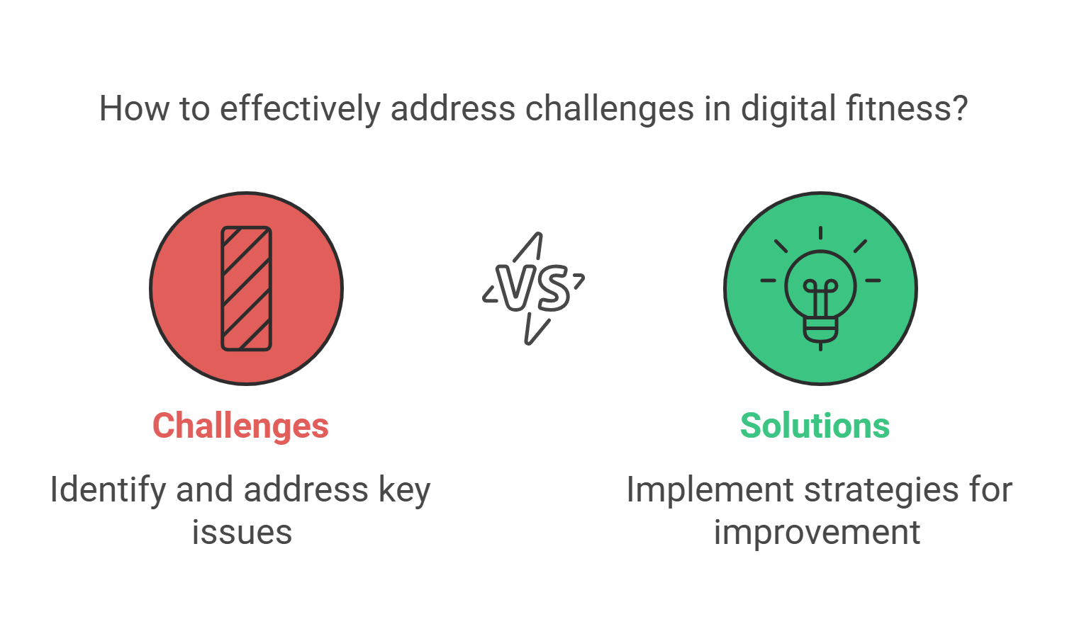
Challenges and Solutions
Challenge: Ensuring compatibility across all devices.
Solution: Implemented a responsive design framework for seamless user experience on desktops, tablets, and smartphones.
Challenge: Attracting user engagement in a competitive digital fitness space.
Solution: Focused on motivational content and user-friendly navigation to keep users interested and coming back.
Challenge: Communicating the value of services effectively.
Solution: Designed a clean layout with clear descriptions of packages, classes, and testimonials to build trust and interest.

Slide 13
Project Benefits
Easy access to gym information anytime and from anywhere
Saves time for users by providing all services in one place
Improves communication between gym and customers
Helps to promote the gym online effectively
Increases user engagement through modern design

Slide 14
Target Audience
Fitness beginners who are starting their fitness journey
Professional athletes seeking advanced training
Gym members looking for flexible membership plans
Health-conscious individuals of all age groups
People searching for online gym information and services
Trainers and fitness professionals

Slide 15
Future Enhancements
Online class booking system
User login and registration
Secure online payment system
Mobile application development
Admin dashboard for system control
AI-based fitness recommendations
Full-stack system upgrade

Slide 16

Conclusion
The ADS Gym Website is a modern and responsive platform designed to inspire fitness enthusiasts and simplify gym interactions. By offering user-friendly navigation, motivational content, and flexible membership options, it successfully builds a supportive fitness community. With potential future enhancements, such as online booking systems and mobile app integration, the project demonstrates scalability and a commitment to evolving user needs.

Slide 17

Thanks!
Do you have any questions?

